Slide 1

Mess Review
An Android app to manage feedback, and show all related query to working to hostel mess system

Slide 2

Logo of our App:-

Slide 3
Problem in current system
Current system of mess feedback exist in form a feedback register which is a volatile material and can be easily misplaced and data in it easily manipulated.
This system also does not ensure that the enquiry or feedback made is heard by the person in IN-Charge.
Also in this approach to problem the student/faculty end up revealing there identity which may be harm to them and human nature gets itself in defensive position when finds out that he/she is wrong.

Slide 4
Solution
Thus we build a simple and efficient app for a fluent system .
The app has elegant looking start page with splash screen.
The app then leads to the start page where one need to login in oder to prevent unwanted filling of data and dubious entry.
The app then leads to the home page, where five options leading to 5 different options in app.
The feedback system is start based and thus easy to use.
And addon is the daily menu showcase, which helps students to order food in advance if the food don’t feel right for there tummy.

Slide 5

Step-1
Press App icon:-

Slide 6

Step:-2
The Splash Screen.
Also the screen is set in order to prevent the splash screen from opening each time the user presses the back button.

Slide 7
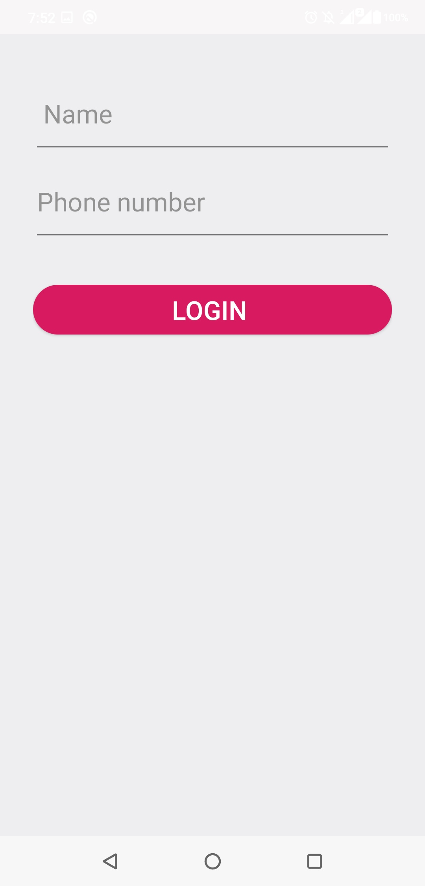
Step-3
The login page .
The user just need to provide the app his/her name and mobile number.

Slide 8

Step:-4
The app screen.
The default menu always is the menu option.

Slide 9
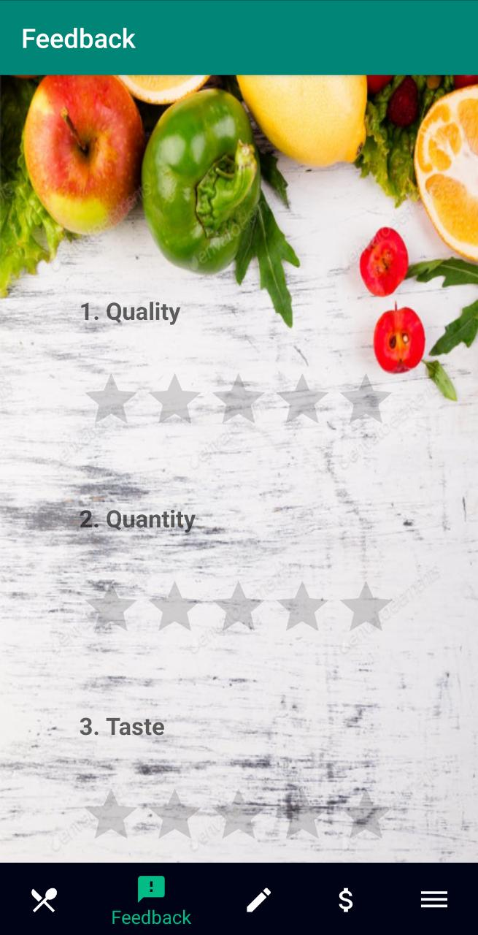
Screen shots from app

Slide 10
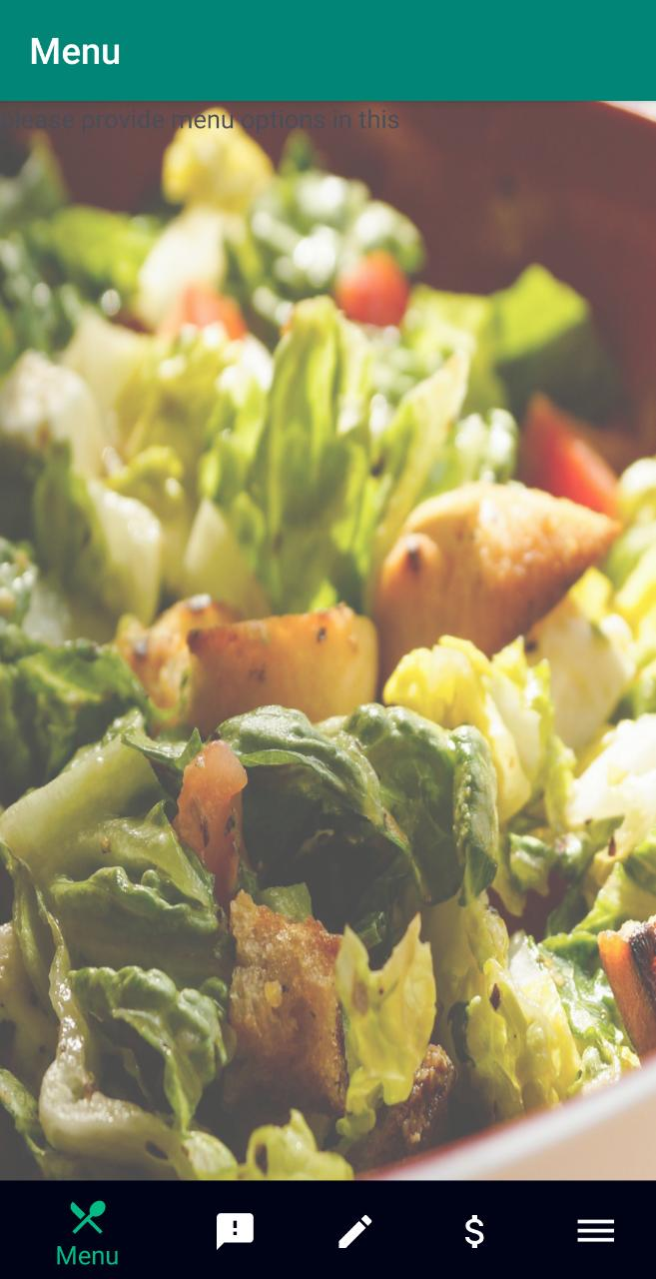
Default screen

Slide 11
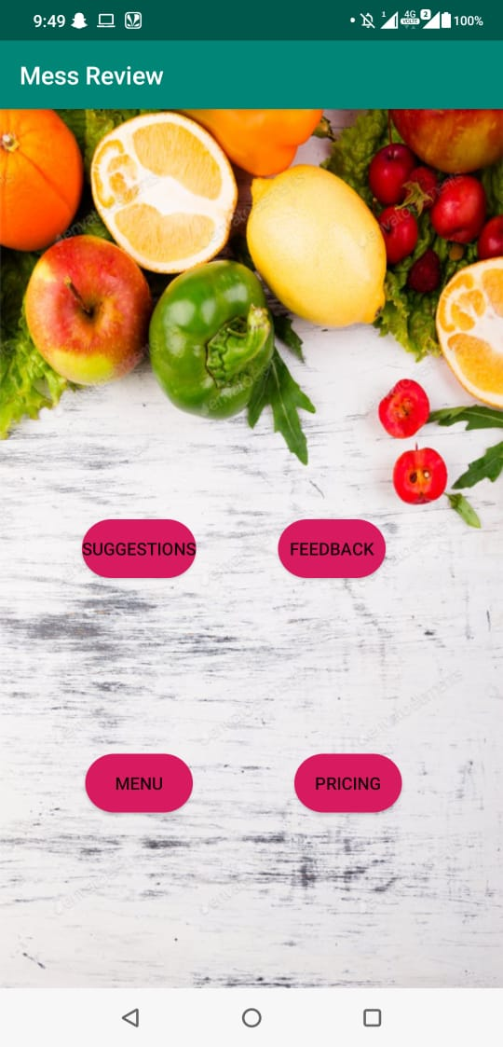
Menu page

Slide 12
Technology/Sources Used
Android studio for base platform to build app.
Java/xml to write the app.
Android libraries to use pre-defined functions.
Stack flow for knowledge.
GitHub for knowledge.
YouTube for knowledge.

Slide 13
Failure Parts
We were not able to link all the fragments.
We tried different approaches for it but failed.

Slide 14
Flow of control
Login
Give name and mobile number
Enter feedback
This is imp.
Feedback saved in Online DB
This to ensure person –in charge have knowledge of all data.

Slide 15
Future possibilities.
The app has potential of resizing.
Push notification to give out notification on mess days with the best food options.
Feedback effect status.
Payment options to help the outsiders pay efficiently for the food,thus enabling digital India.
Linking of a health app with it would help gym people to get all the info and thus help plan meals.

Slide 16
Available
This is a open source project and is avaible for free under MIT licence at GitHub under the following name and the Url to it is also directly stated below.

Slide 17
Crdiets
This is been a synchronised project between 3 team members.
Member 1-Utkarsh Prakash Srivastava
Git hub:-utkarsh231
Member 2-Kshitij Pathak
Git Hub:-dev-bot1
Member 3-Kaushik Gupta
Git Hub:-kaushi397

Slide 18

Thank You

